Slide 1
Warm up.
Find the length of the line between the following points.
(4,6) and (10, 9)
(-2, 7) and (12, -30)

Slide 2
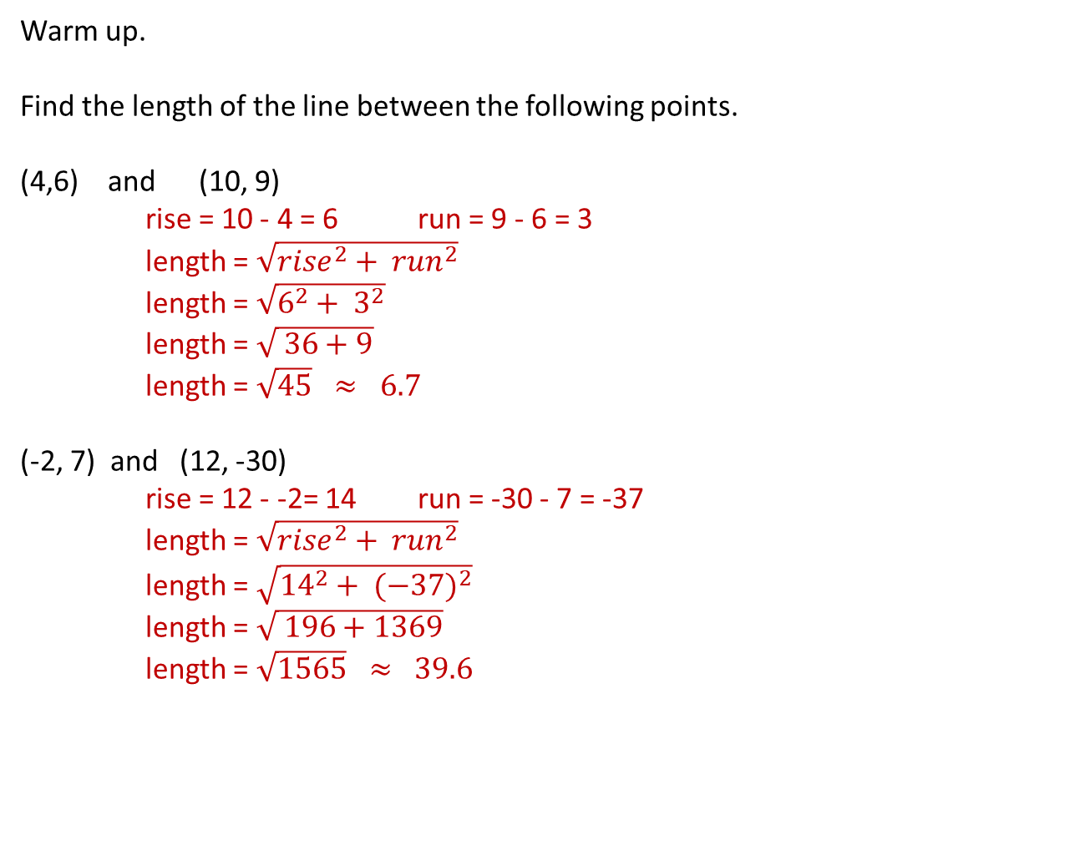
Warm up.
Find the length of the line between the following points.
(4,6) and (10, 9)
rise = 10 - 4 = 6 run = 9 - 6 = 3
length = $\sqrt{{rise}^{2}+ {run}^{2}}$
length = $\sqrt{6^{2}+ 3^{2}}$
length = $\sqrt{ 36+9}$
length = $\sqrt{45} ≈ 6.7$
(-2, 7) and (12, -30)
rise = 12 - -2= 14 run = -30 - 7 = -37
length = $\sqrt{{rise}^{2}+ {run}^{2}}$
length = $\sqrt{{14}^{2}+ {(−37)}^{2}}$
length = $\sqrt{ 196+1369}$
length = $\sqrt{1565} ≈ 39.6$

Slide 3
Finding the midpoint between 2 points
L.O. Students will learn how to find the midway point on a line between 2 points on a cartesian plane.

Slide 4
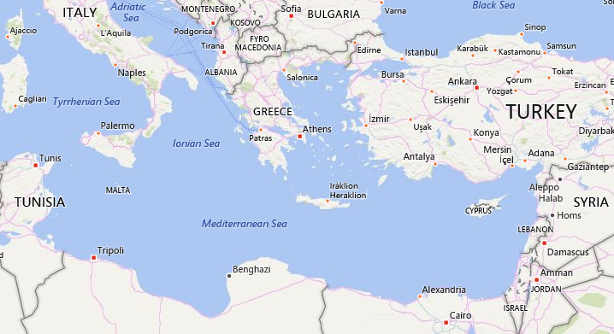
(36,14)
(31,30)
Marcus is running search and rescue for a ship that has reported it’s position as halfway between the Egyptian city Alexandria and the Island of Malta. Marcus has drawn a line between the two locations, but now he needs the coordinates of the mid point.

Slide 5

(36,14)
(31,30)
If we again draw in our rise and our run as lines, we can see we have gone 5 degrees South and 16 degrees East to go from Malta to Alexandria.
Halfway would therefore be 2.5 degrees South and 8 degrees East (1/2 the distance South and 1/2 the distance East.

Slide 6
(36,14)
(33.5,22)
(31,30)
An easy way to calculate the value of the point is to;
1. add the x values together and divide by 2 to get the x value of the ½ way point.
(36 + 31) ÷ 2 = 33.5
2. add the y values together and divide by 2 to get the y value of the ½ way point.
(14 + 30) ÷ 2 = 22

Slide 7
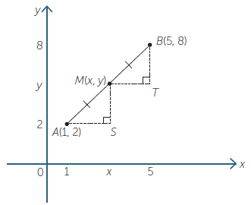
24
7
30
Date
Topic : Coordinate Geometry
EQ – How do we find the midpoint of a line from its coordinates?
To find the mid point of a line using its coordinates.
1. add the two x values and divide by 2 to get the x value of the midpoint
2. add the two y values and divide by 2 to get the y value of the midpoint.
Eg
Find the coordinates for the mid point
Add the x values from the points and
divide by 2
(1 + 5)÷2 = 3
Add the y values from the points and
divide by 2
(2 + 8)÷2 = 5
Combine the x and y values into coordinates
Midpoint = (3,5)

Slide 8
Try these
a) (2, 5) and (4, 9)
b) (0, 0) and (8, – 6)
c) (–2, – 7) and (6, 1)
d) (– 8, – 9) and (0, – 9)
e) (–2, –7) and (3, 11)
f) (– 5, 2) and (0, 0)
g) (–3.5, 2.5) and (1.5, 5.5)
h) (1, 5) and (1, 6)

Slide 9
Practice
Dr Dwyer Exercise 16.5 on page 216 and 217

